Slide 1

Module 7: Data Wrangling: Join, combine, & reshape
DS 522 Data Acquisition and Analytics

Slide 2
AGENDA
Hierarchical Indexing
Combining and Merging Datasets
Reshaping and Pivoting

Slide 3
Hierarchical Indexing

Slide 4
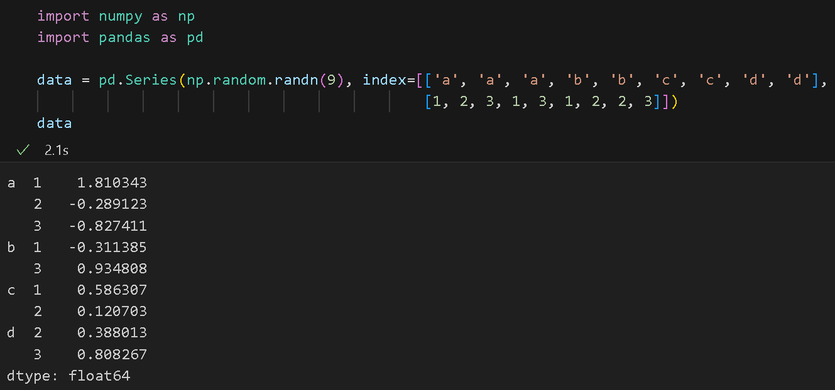
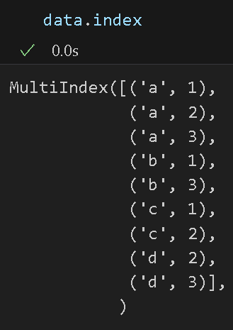
Hierarchical Indexing
Hierarchical Indexing is an important feature of pandas that allows us to have a multiple (two or more) index levels on an axis.
It provides a way to work with higher dimensional data in a lower dimensional form.
Example:

Slide 5
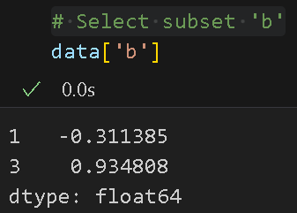
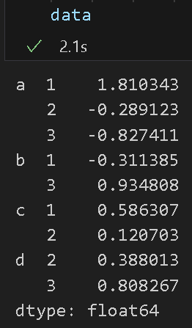
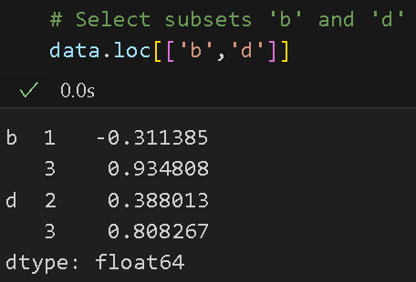
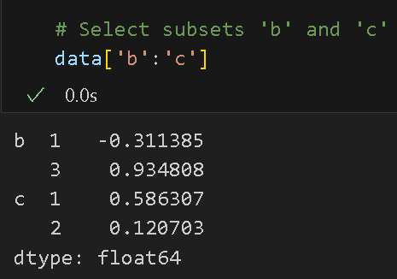
HIERARCHICAL INDEXING
Partial indexing - is possible in a hierarchically indexed object & allows to select subsets of the data

Slide 6
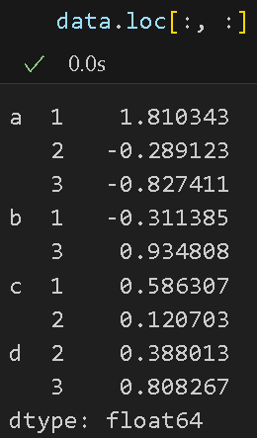
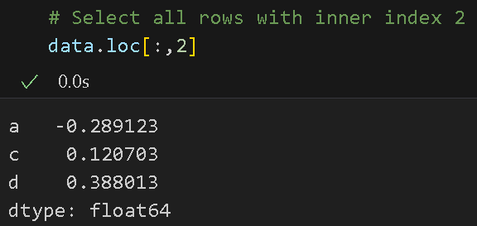
Hierarchical Indexing
It is even possible to have partial indexing from an “inner” level.
What would data.loc[:, :] show?

Slide 7
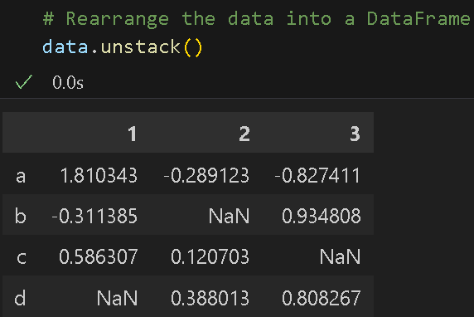
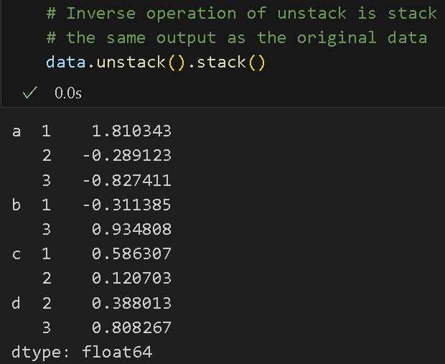
Hierarchical Indexing
Important in reshaping data and group-based operations like forming a pivot table.
Rearrange the data into a DataFrame using stack() & unstack()
The inverse operation of unstack is stack():

Slide 8
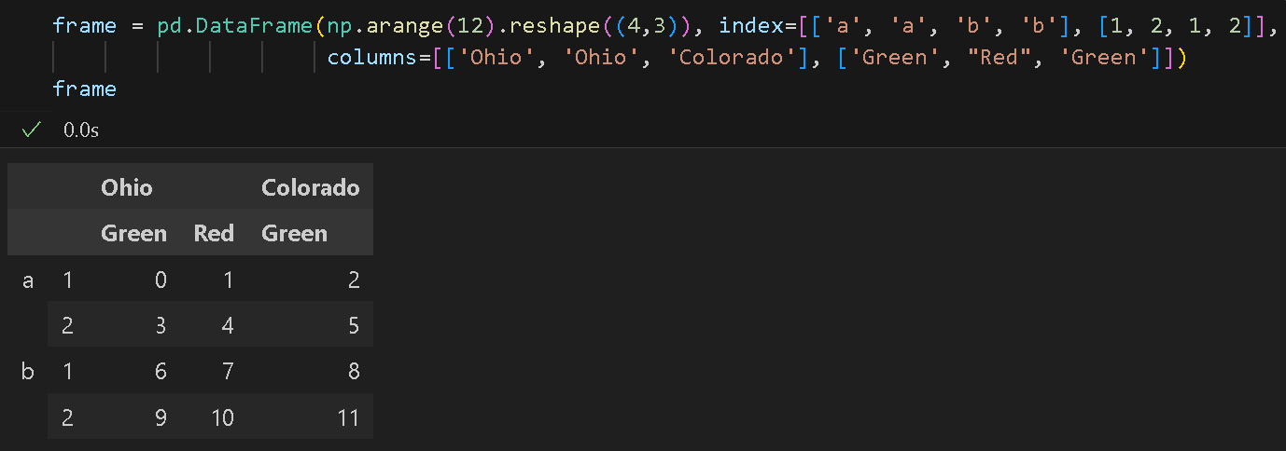
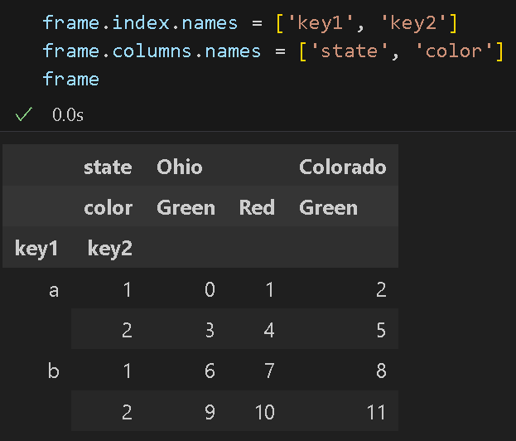
Hierarchical Indexing
Either axis can have a hierarchical index in a DataFrame.
Include names of the hierarchical levels.

Slide 9
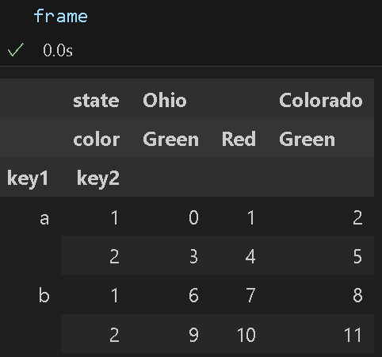
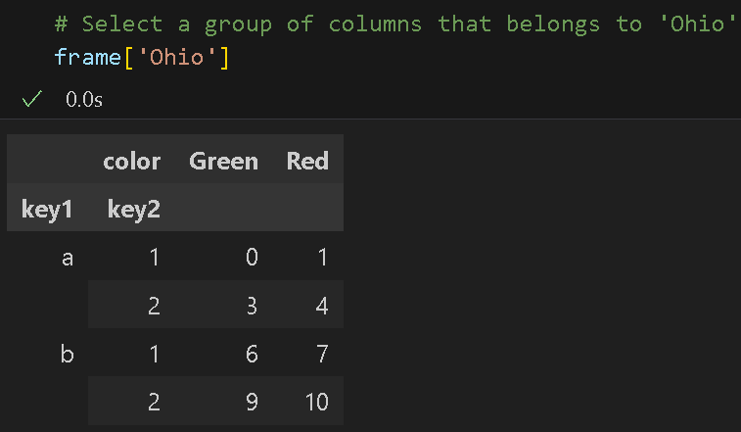
Hierarchical Indexing
Select groups of columns with partial column indexing of columns:

Slide 10
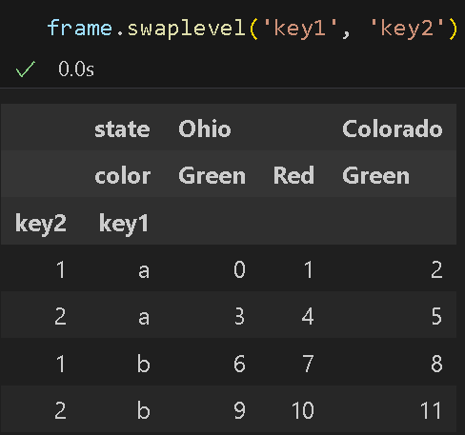
Reordering and Sorting Levels
swaplevel takes two level numbers of names and returns a new object with the levels interchanged. (but data is unchanged)
Original frame:

Slide 11
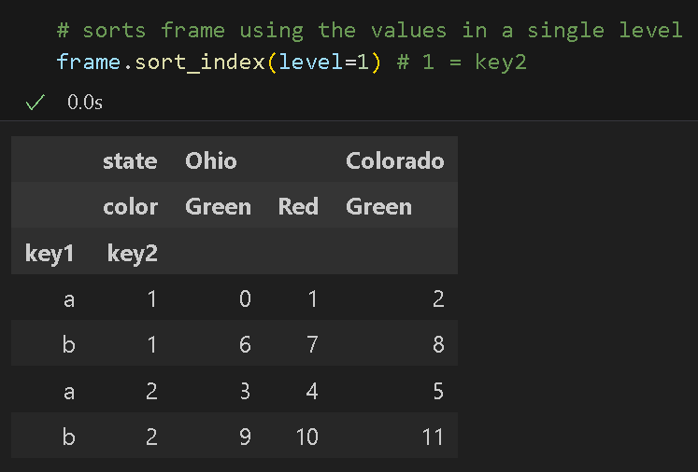
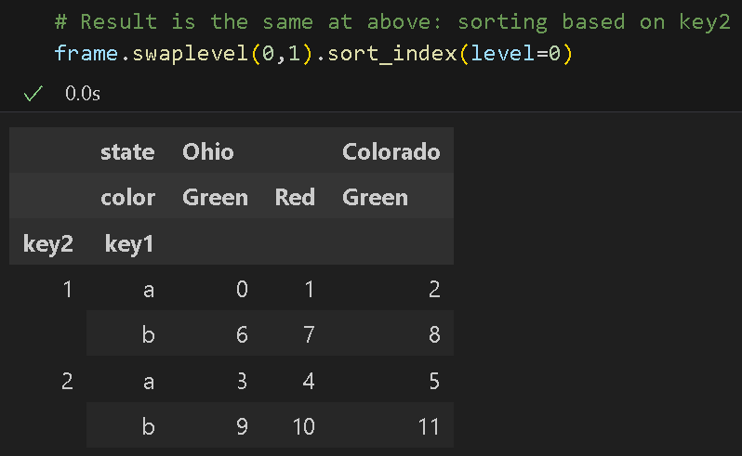
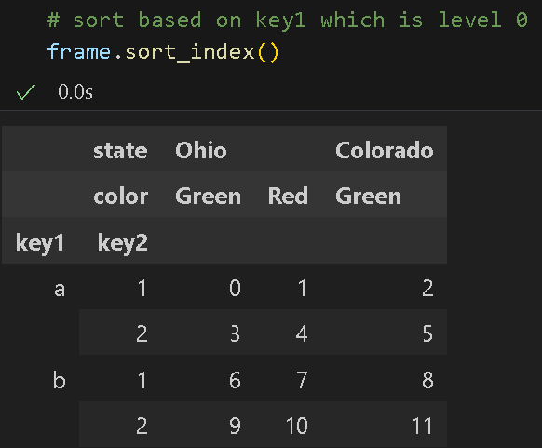
Reordering and Sorting Levels
sort_index - sorts the data using the values in a single level

Slide 12
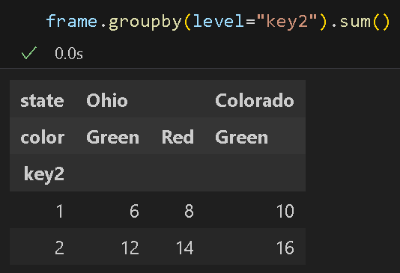
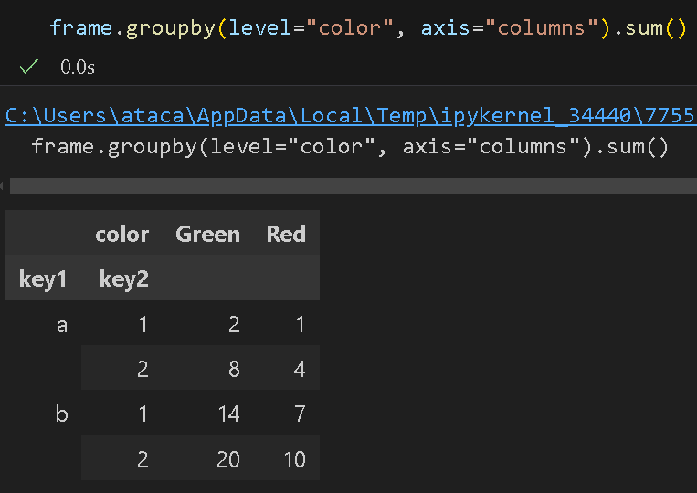
Summary Statistics by Level
level - allows you to aggregate by the level on a particular axis (rows and columns)

Slide 13
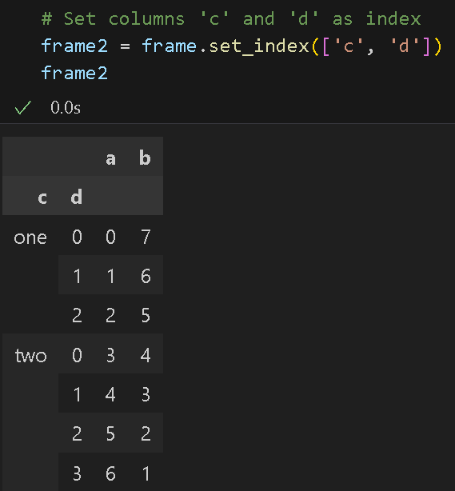
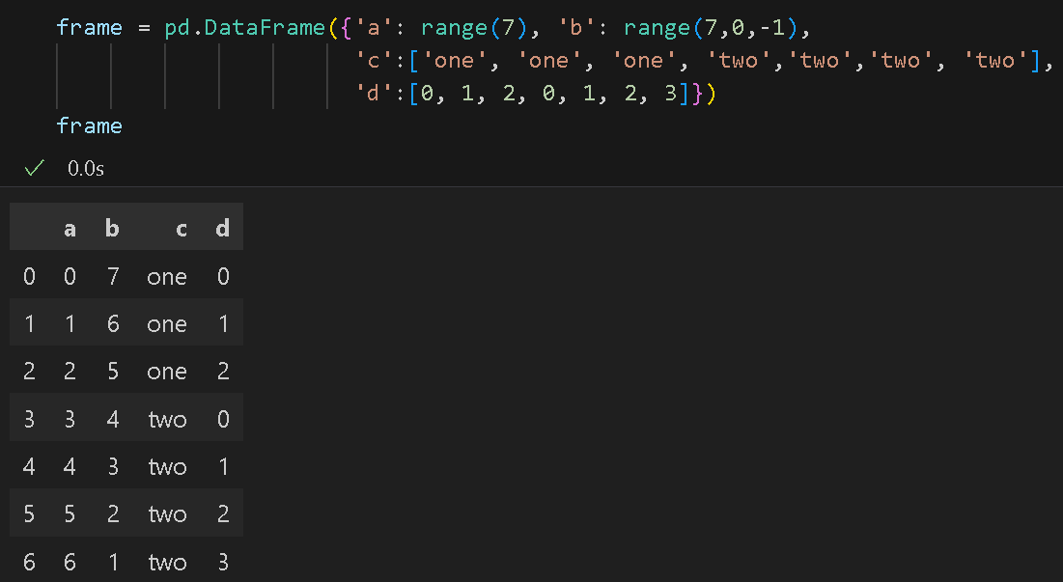
Indexing with a DataFrame’s Columns
set_index - method use to change dataframe index using one or more of its columns as index:

Slide 14
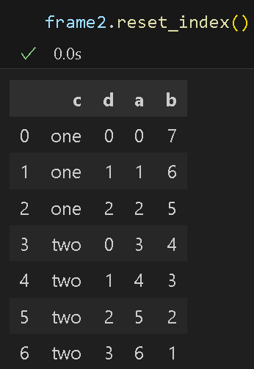
Indexing with a DataFrame’s Columns
reset_index use to move hierarchical index levels into columns.

Slide 15
Combining and Merging Datasets

Slide 16
Combining and Merging Datasets
Data in pandas objects can be combined in a number of ways:
merge - connects rows in DataFrames based on one or more keys. It implements join operations in database.
concat - concatenates or “stacks” objects together along an axis.
- stacks DataFrames vertically / horizontally
combine_first - enables slicing together overlapping data to fill in missing values in one object with values from another.

Slide 17
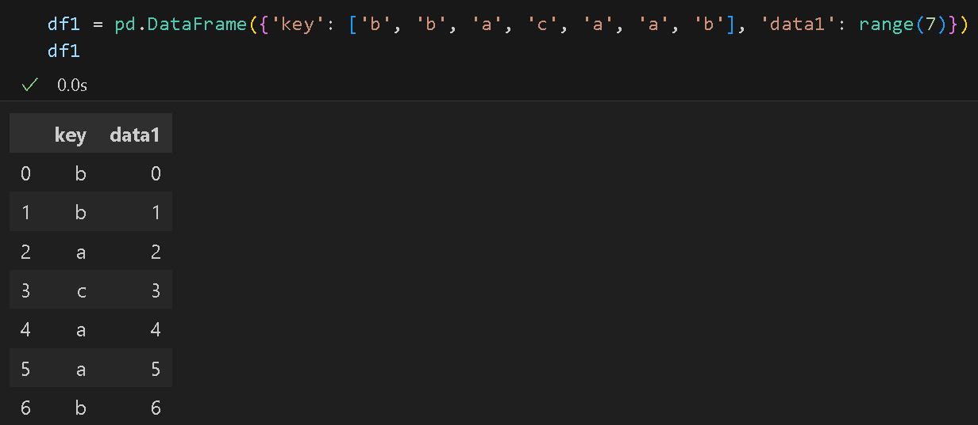
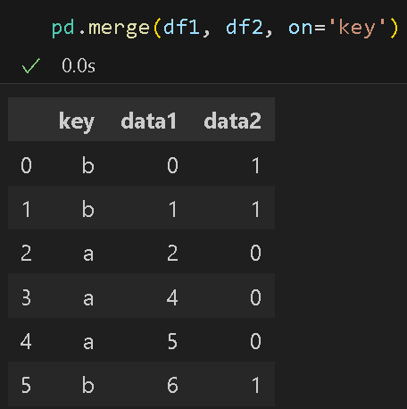
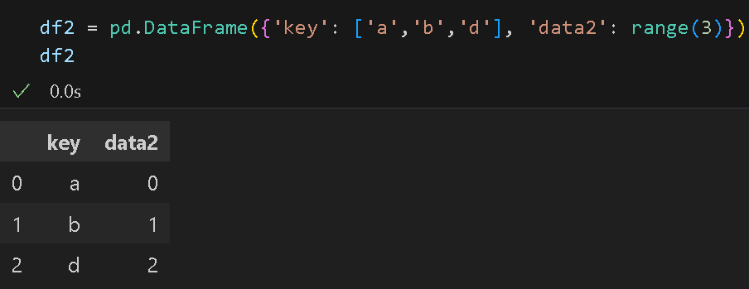
Database-Style DataFrame Joins
merge - combines datasets by linking rows using one or more keys
Example: many-to-one join using merge ​

Slide 18
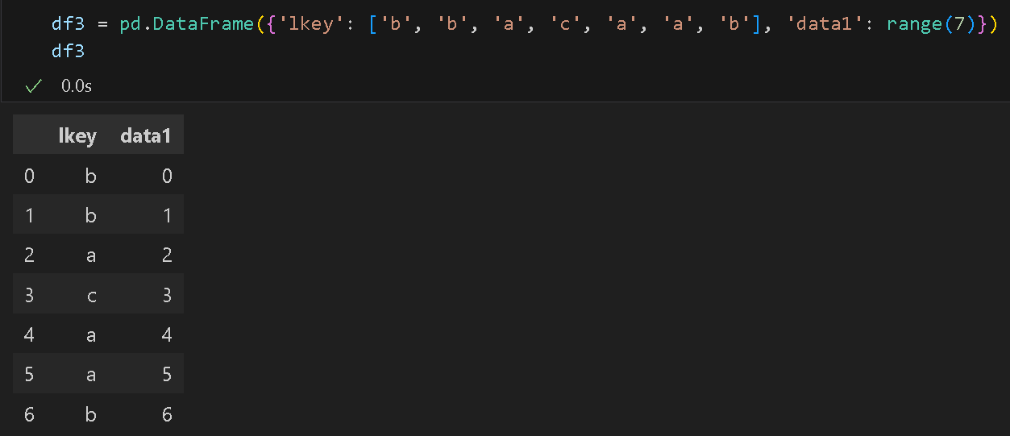
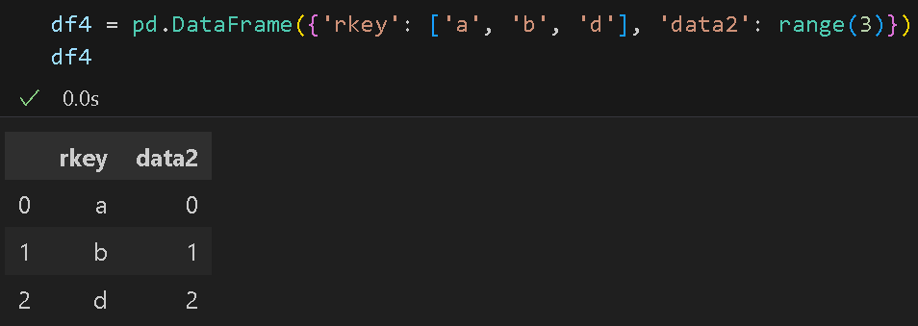
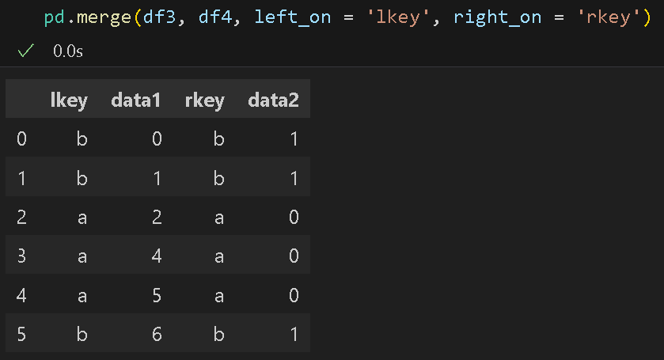
Database-Style DataFrame Joins
If the column names are different in each object, we can specify them separately.
Notice there is no ‘c’, or ‘d’. Why?

Slide 19
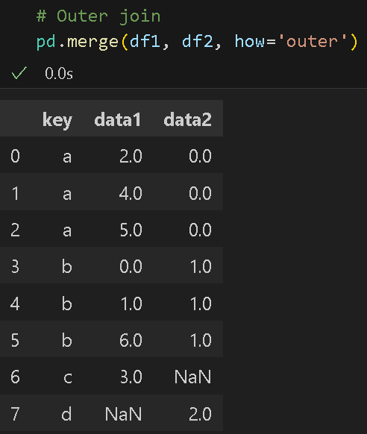
Database-Style DataFrame Joins
By default, merge does an ‘inner’ join.
Other options: ‘left’, ‘right’, and ‘outer’

Slide 20
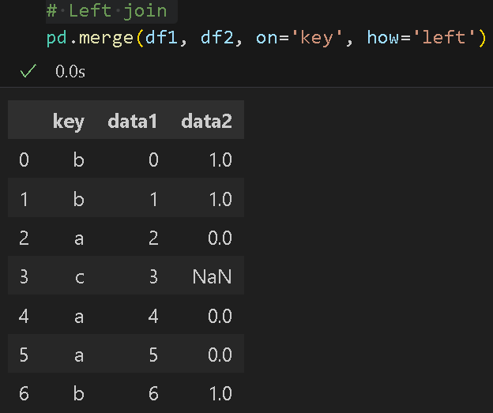
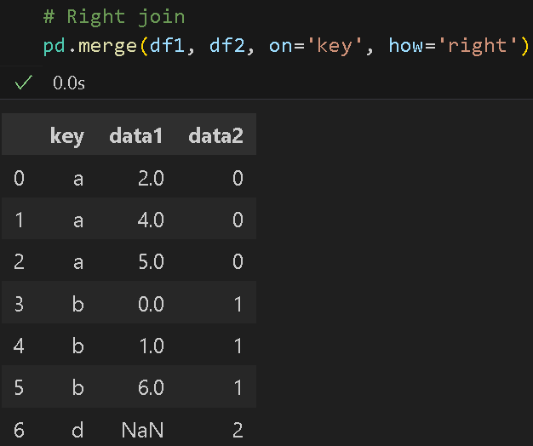
Database-Style DataFrame Joins
Left join
Right join

Slide 21
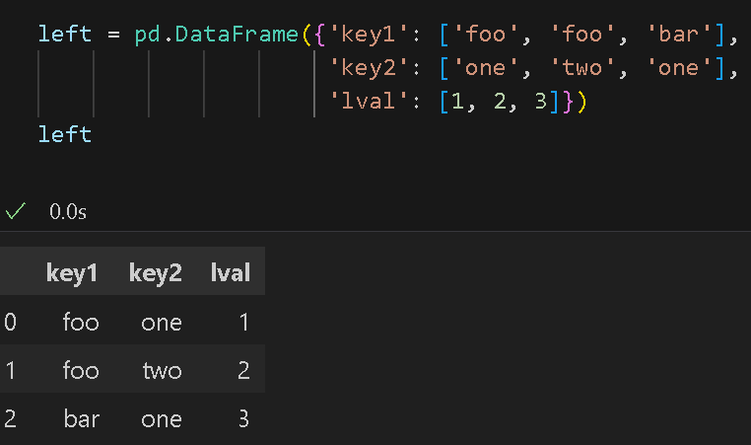
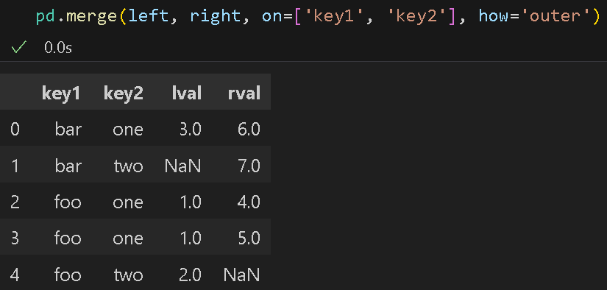
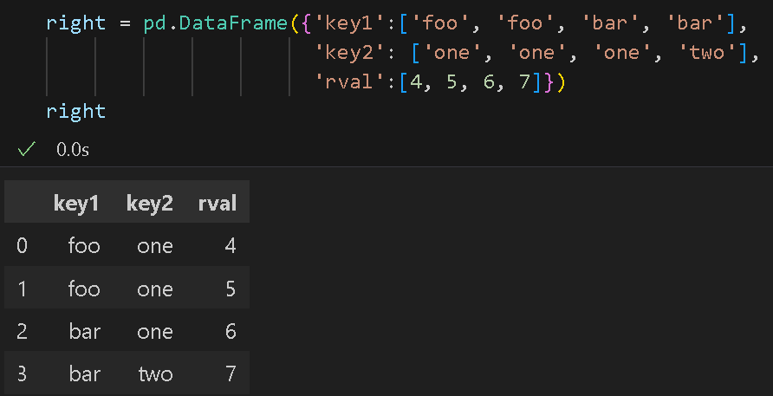
Database-Style DataFrame Joins
Merge with multiple keys:

Slide 22
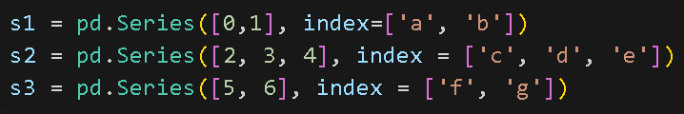
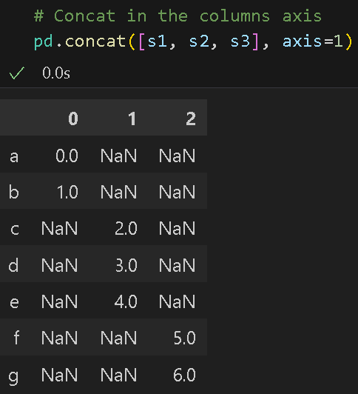
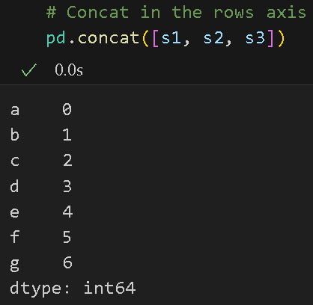
Concatenating Along an Axis
concat - provides a consistent way to combine data
- glues together the values and indexes in a list

Slide 23
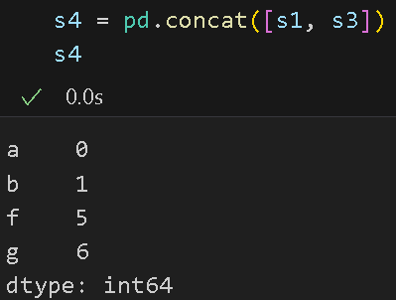
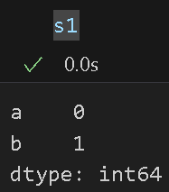
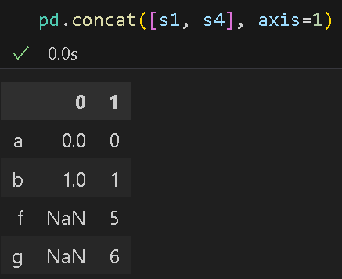
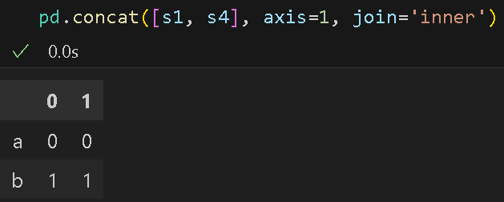
Concatenating Along an Axis
Let’s look at a case where there is an overlap of an index.
In this case, the ‘f’ and ‘g’ labels disappear because of the join=‘inner’ option.

Slide 24
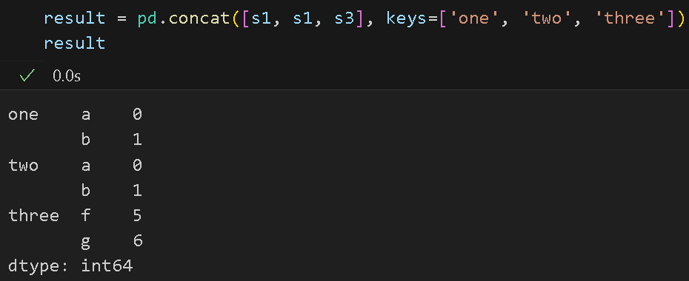
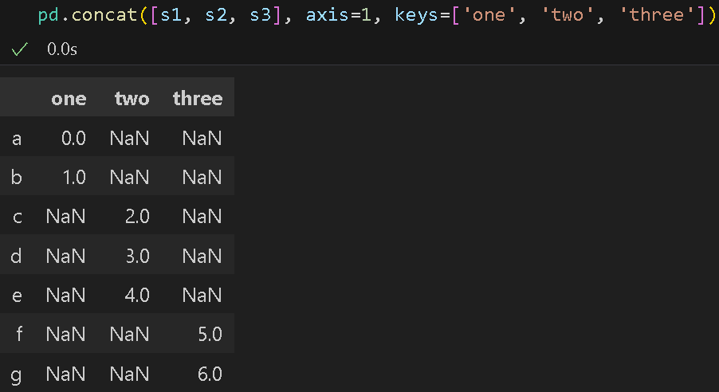
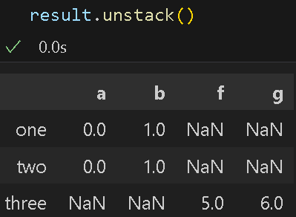
Concatenating Along an Axis
Create a hierarchical index on the concatenation axis

Slide 25
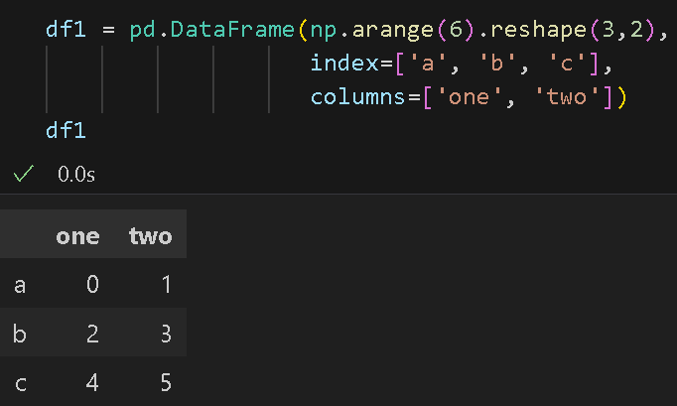
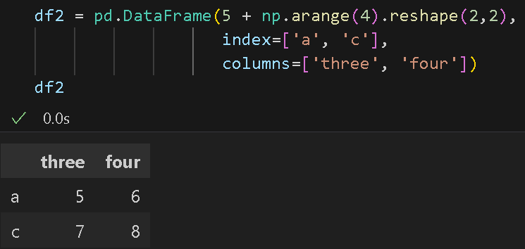
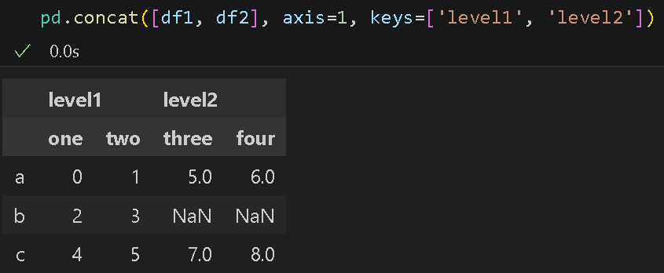
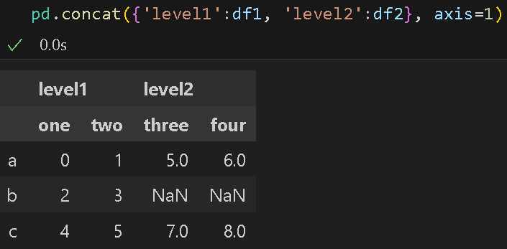
Concatenating Along an Axis
The same logic extends to DataFrame objects
You can pass a dict of objects instead of a list.

Slide 26
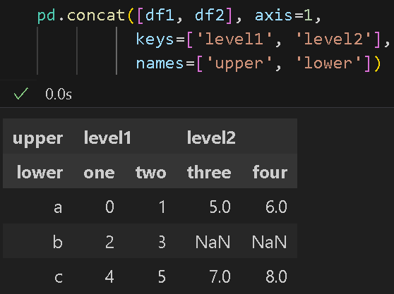

Concatenating Along an Axis
Create name for axis levels with the names argument.
Same result without the names for axis levels

Slide 27



Concatenating Along an Axis
pass ignore_index=True if the row index does not contain any relevant data

Slide 28



Combining Data with Overlap
Using where function for data with overlap:

Slide 29
Reshaping and Pivoting

Slide 30
Reshaping with Hierarchical Indexing
Reshape data and apply group-based operations like forming a pivot table in hierarchical indexing.
Consistently rearrange the data into a DataFrame using stack() & unstack()
stack():
rotates or pivots from columns to rows
unstack():
pivots from rows into columns

Slide 31



Reshaping with Hierarchical Indexing
stack():
rotates or pivots from columns to rows
unstack():
pivots from rows into columns

Slide 32


Reshaping with Hierarchical Indexing
Default:
stack the innermost level
unstack the innermost level
level = option to change defaults
Note: The level unstacked becomes the lowest level in the result; i.e., ‘state’ is the lowest level.

Slide 33


Reshaping with Hierarchical Indexing
Default:
stack the innermost level
unstack the innermost level
level = option to change defaults

Slide 34

Pivoting ’Long’ to ‘Wide’ Format
‘long’ & ‘wide’ - common way to store multiple time series in databases and CSV files.
individual values are represented by a single row in a table rather than multiple values per row.
Example: macrodata.csv

Slide 35


Pivoting ’Long’ to ‘Wide’ Format
pandas.PeriodIndex - represents time intervals rather than points in time
Example: macrodata.csv
Step 1. Use pandas.PeriodIndex - to combine the year and quarter columns to set the index to consist of datetime values at the end of each quarter

Slide 36

Pivoting ’Long’ to ‘Wide’ Format
Step 2. Select a subset of columns and give the columns index the name "item":

Slide 37

Pivoting ’Long’ to ‘Wide’ Format
Step 3. Reshape with stack, turn the new index levels into columns with reset_index, and finally give the column containing the data values the name "value":
Long format -each row in
the table represents a single
observation for multiple
time series.

Slide 38

Pivoting ’Long’ to ‘Wide’ Format
Step 4. Use pivot() to transform a DataFrame to have one column per distinct item value indexed by timestamps in the date column.

Slide 39


Pivoting ’Long’ to ‘Wide’ Format
Step 4. Use pivot() to reshape two value columns simultaneously

Slide 40
Pivoting ‘Wide’ to ’Long’ Format
melt():
- the opposite of pivot()
Use to merge multiple columns into one, producing a DataFrame that is longer than the input
Creates a DataFrame from ‘Wide’ to ’Long’ Format

Slide 41


Pivoting ‘Wide’ to ’Long’ Format
melt() - Creates a DataFrame from ‘Wide’ to ’Long’ Format
Example: With group identifier
id_vars will keep ‘key’ unchanged

Slide 42

Pivoting ‘Wide’ to ’Long’ Format
melt() - Creates a DataFrame from ‘Wide’ to ’Long’ Format
Example: With a specific subset of columns as value columns

Slide 43

Pivoting ‘Wide’ to ’Long’ Format
melt() - Creates a DataFrame from ‘Wide’ to ’Long’ Format
Example: Without group identifier

Slide 44

Pivoting ‘Wide’ to ’Long’ Format
melt() - Creates a DataFrame from ‘Wide’ to ’Long’ Format
Example: Use pivot() to undo melt()

Slide 45
References
reference
McKinney, W. (2022). Python for Data Analysis: Data Wrangling with Pandas, Numpy, and IPython. O’Reilly. (ISBN: 1-0981-0402-1)
McKinney, W. (2022). Python for Data Analysis: Data Wrangling with Pandas, Numpy, and IPython. O’Reilly. (ISBN: 1-0981-0402-1)

Slide 46

Thank you!

